Slide 1
Introduction to Computational Thermodynamics
Section 2.2
Activity Coefficient Models

Slide 2
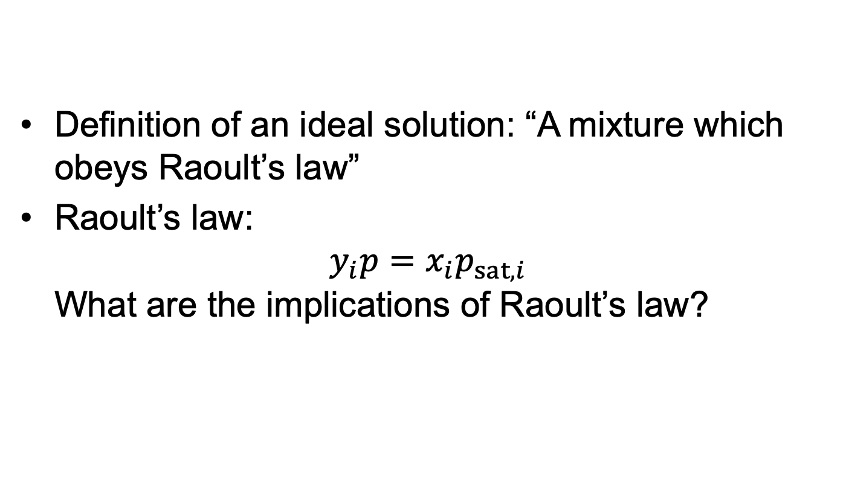
Recap: Ideal Solution
Definition of an ideal solution: “A mixture which obeys Raoult’s law”
Raoult’s law: $y_{i}p=x_{i}p_{sat,i}$ What are the implications of Raoult’s law?

Slide 3
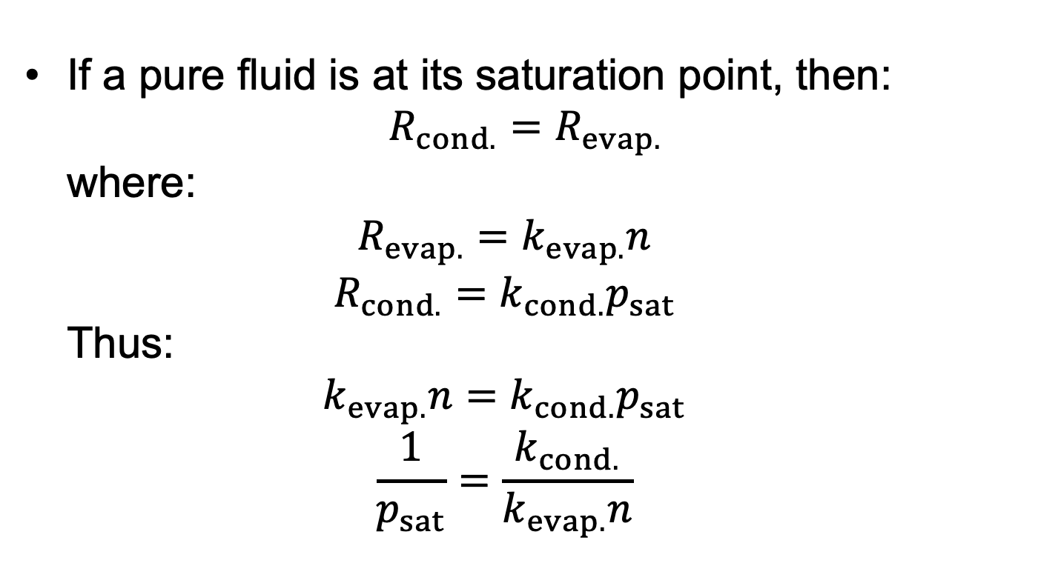
Recap: Ideal Solution
If a pure fluid is at its saturation point, then: $R_{cond.}=R_{evap.}$ where: $R_{evap.}=k_{evap.}n$ $R_{cond.}=k_{cond.}p_{sat}$ Thus: $k_{evap.}n=k_{cond.}p_{sat}$ $\frac{1}{p_{sat}}=\frac{k_{cond.}}{k_{evap.}n}$

Slide 4

Recap: Ideal Solution
For a mixture at its bubble point: Then: $R_{A,evap.}=k_{A,evap.}n_{A}=k_{A,evap.}x_{A}n$ $R_{A,cond.}=k_{A,cond.}p_{A}=k_{A,cond.}y_{A}p$

Slide 5
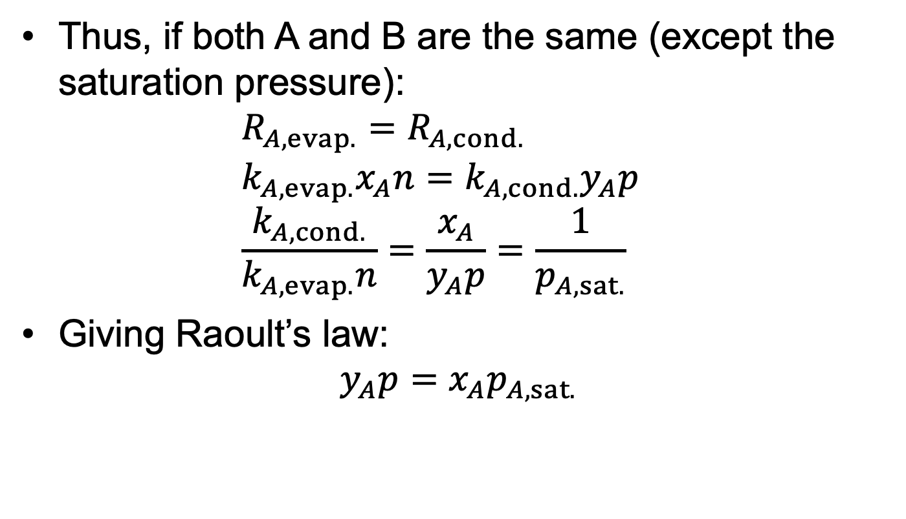
Recap: Ideal Solution
Thus, if both A and B are the same (except the saturation pressure): $R_{A,evap.}=R_{A,cond.}$ $k_{A,evap.}x_{A}n=k_{A,cond.}y_{A}p$ $\frac{k_{A,cond.}}{k_{A,evap.}n}=\frac{x_{A}}{y_{A}p}=\frac{1}{p_{A,sat.}}$
Giving Raoult’s law: $y_{A}p=x_{A}p_{A,sat.}$

Slide 6
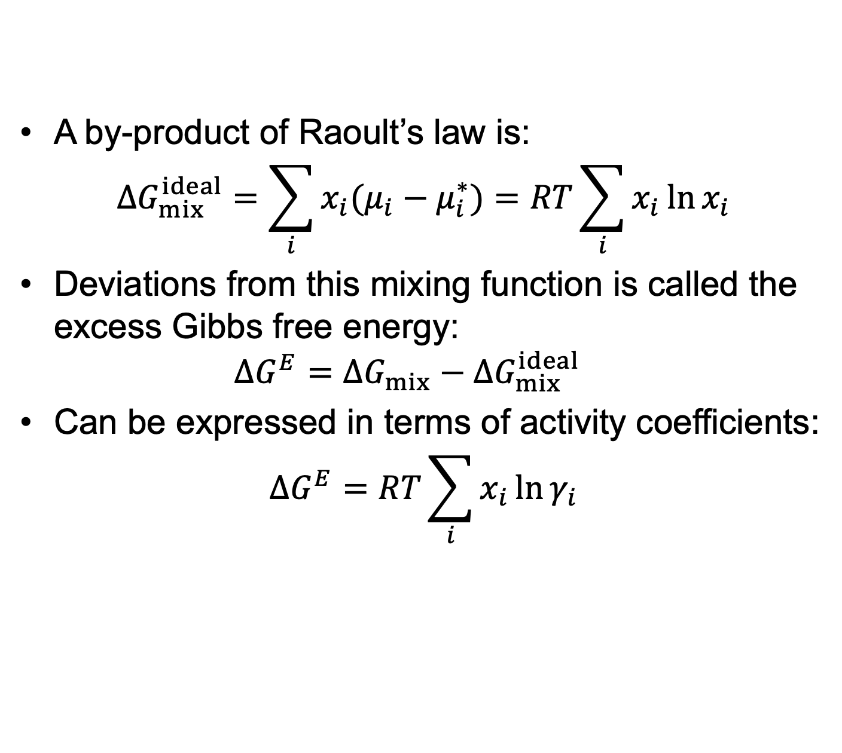
Deviations from ideal solution
A by-product of Raoult’s law is: $ΔG_{mix}^{ideal}=\sum_{i}{x_{i}(μ_{i}−μ_{i}^{∗})}=RT\sum_{i}{x_{i}\ln{x_{i}}}$
Deviations from this mixing function is called the excess Gibbs free energy: $ΔG^{E}=ΔG_{mix}−ΔG_{mix}^{ideal}$
Can be expressed in terms of activity coefficients: $ΔG^{E}=RT\sum_{i}{x_{i}\ln{γ_{i}}}$

Slide 7
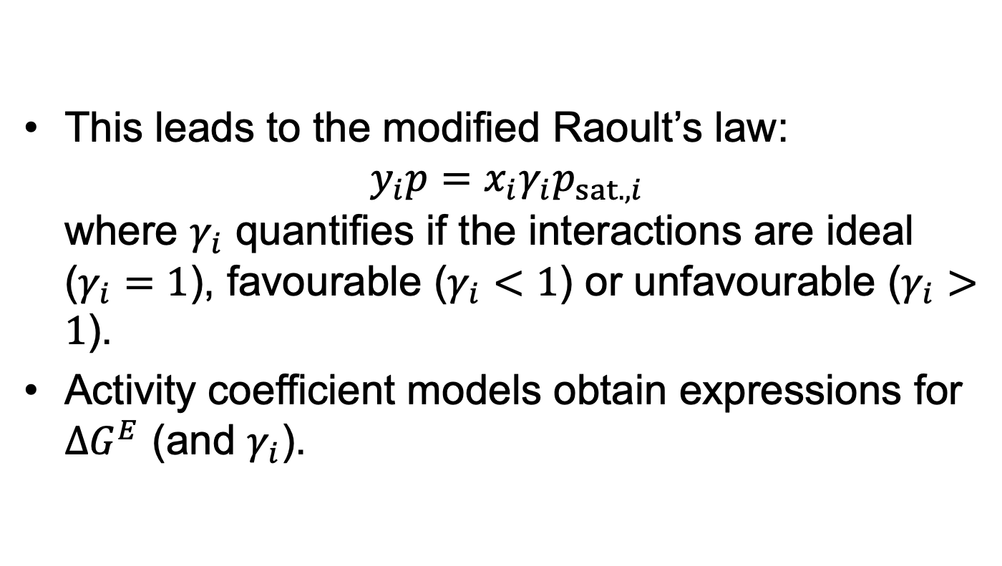
Deviations from ideal solution
This leads to the modified Raoult’s law: $y_{i}p=x_{i}γ_{i}p_{sat.,i}$ where $γ_{i}$ quantifies if the interactions are ideal ($γ_{i}=1$), favourable ($γ_{i}<1$) or unfavourable ($γ_{i}>1$).
Activity coefficient models obtain expressions for $ΔG^{E}$ (and $γ_{i}$).

Slide 8
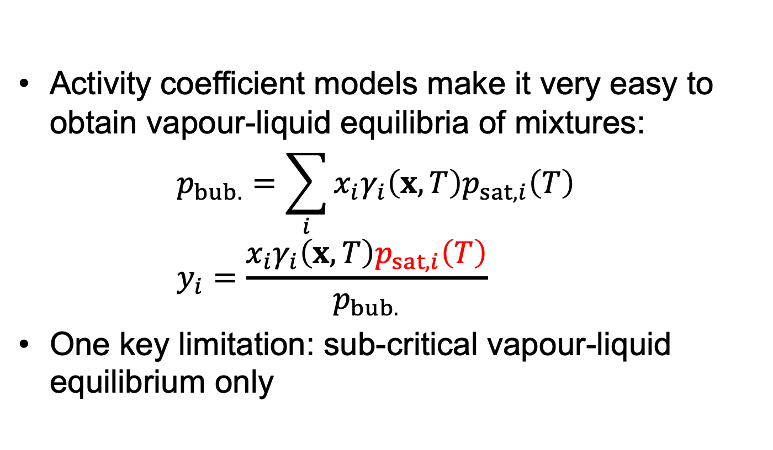
Pros and Cons
Activity coefficient models make it very easy to obtain vapour-liquid equilibria of mixtures: $p_{bub.}=\sum_{i}{x_{i}γ_{i}\left(x,T\right)p_{sat,i}\left(T\right)}$ $y_{i}=\frac{x_{i}γ_{i}\left(x,T\right)p_{sat,i}\left(T\right)}{p_{bub.}}$
One key limitation: sub-critical vapour-liquid equilibrium only

Slide 9
Pros and Cons
Activity coefficient models cannot be used on their own.
Need an ancillary model to obtain the saturation pressure (e.g. Antoine equation).
Cannot be used to obtain bulk properties.

Slide 10
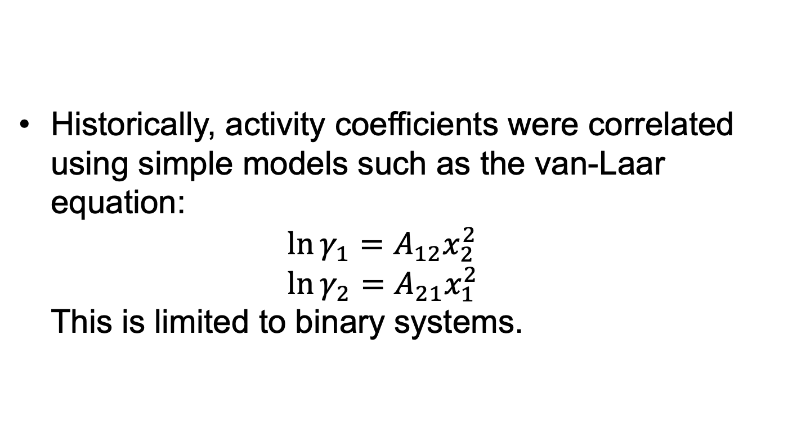
Wilson Equation
Historically, activity coefficients were correlated using simple models such as the van-Laar equation: $\ln{γ_{1}}=A_{12}x_{2}^{2}$ $\ln{γ_{2}}=A_{21}x_{1}^{2}$ This is limited to binary systems.

Slide 11

Wilson Equation
In 1964, Wilson came up with the idea of a ‘local composition’ approach.
The composition of species $j$ around species $i$ wasn’t the same as in the bulk:

Slide 12
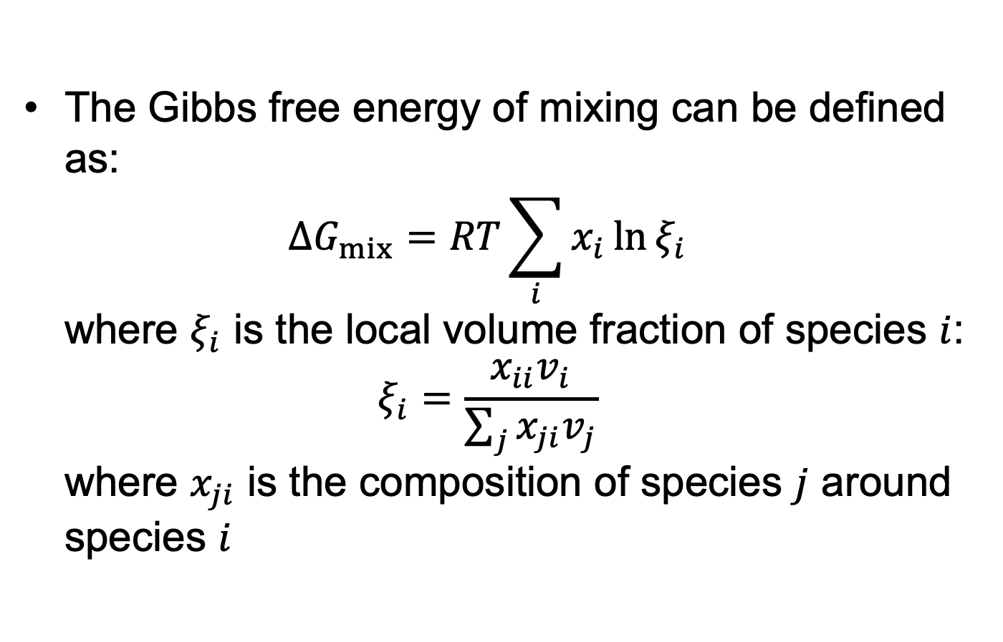
Wilson Equation
The Gibbs free energy of mixing can be defined as: $ΔG_{mix}=RT\sum_{i}{x_{i}\ln{ξ_{i}}}$ where $ξ_{i}$ is the local volume fraction of species $i$: $ξ_{i}=\frac{x_{ii}v_{i}}{\sum_{j}{x_{ji}v_{j}}}$ where $x_{ji}$ is the composition of species $j$ around species $i$

Slide 13
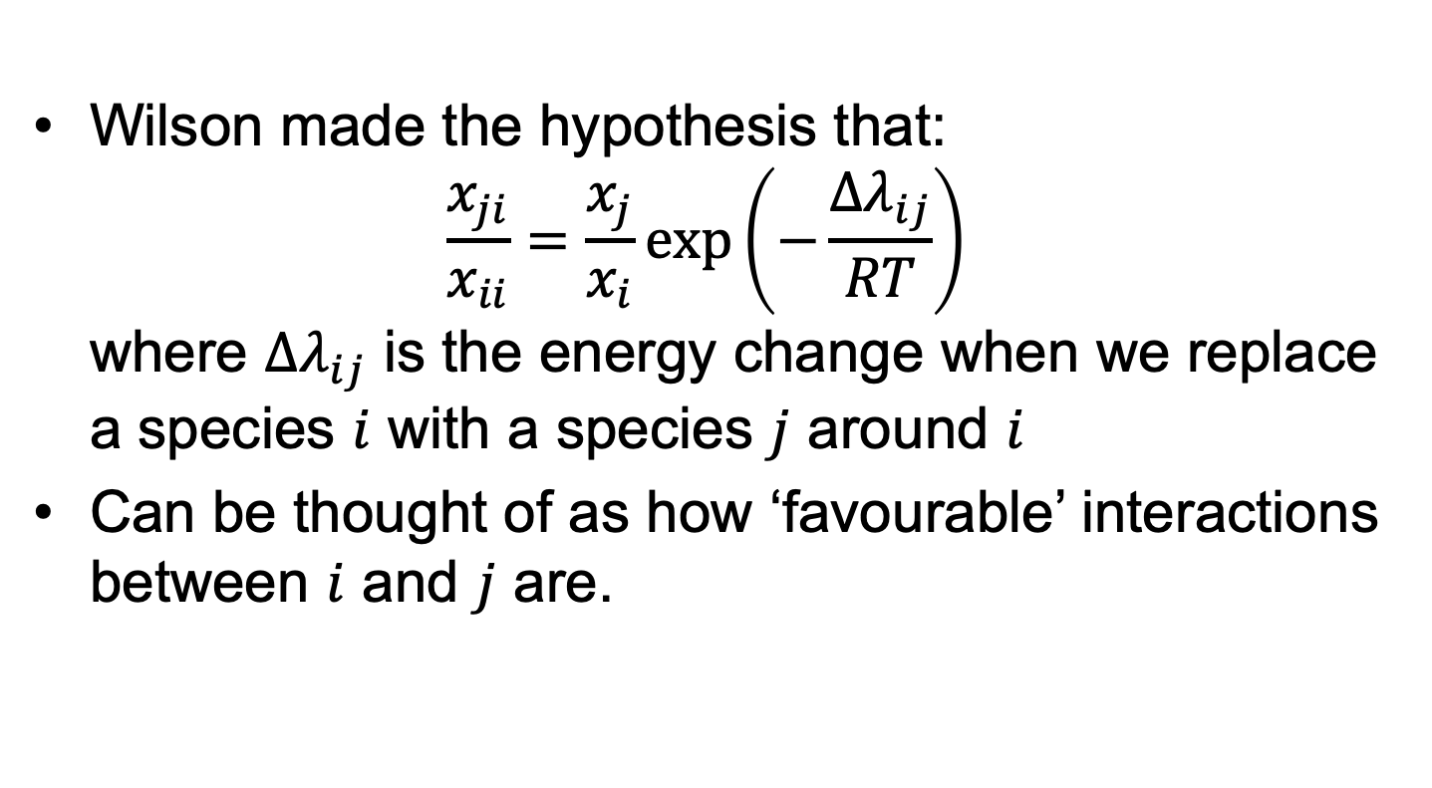
Wilson Equation
Wilson made the hypothesis that: $\frac{x_{ji}}{x_{ii}}=\frac{x_{j}}{x_{i}}\exp\left(−\frac{Δλ_{ij}}{RT}\right)$ where $Δλ_{ij}$ is the energy change when we replace a species $i$ with a species $j$ around $i$
Can be thought of as how ‘favourable’ interactions between $i$ and $j$ are.

Slide 14
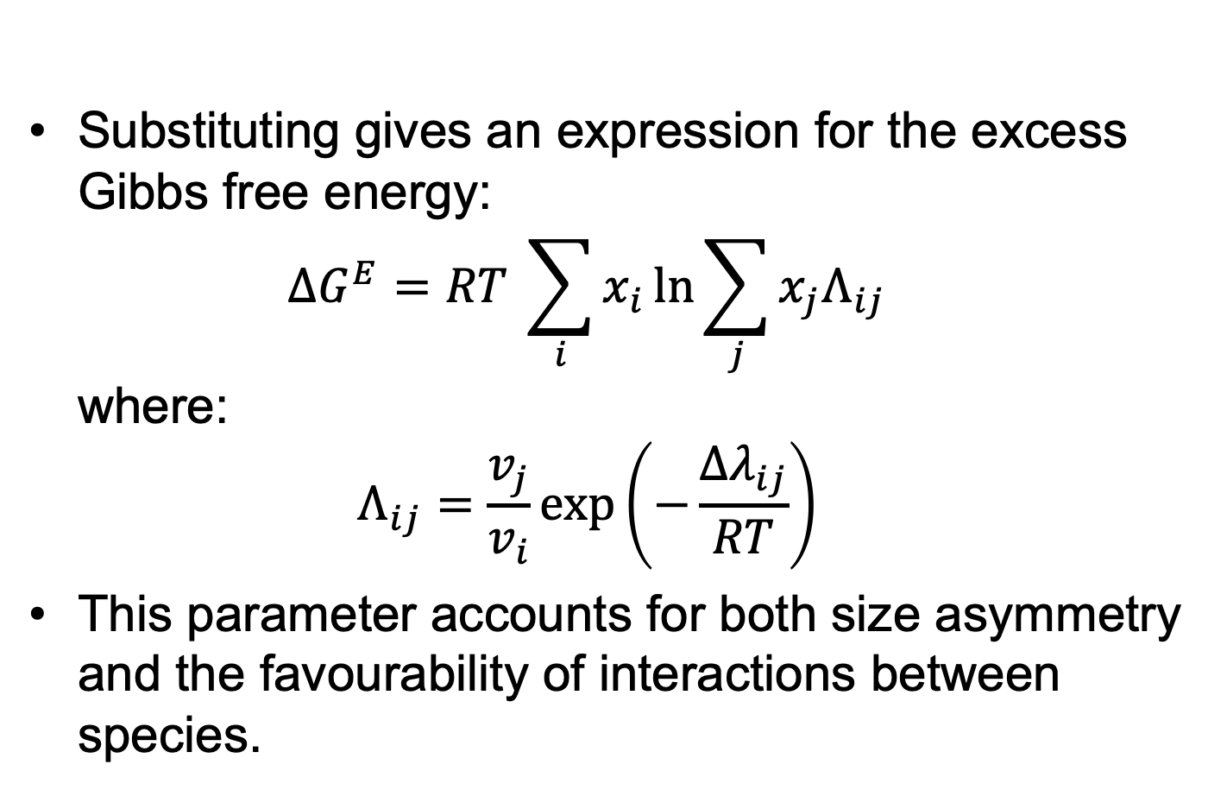
Wilson Equation
Substituting gives an expression for the excess Gibbs free energy: $ΔG^{E}=RT \sum_{i}{x_{i}\ln{\sum_{j}{x_{j}Λ_{ij}}}}$ where: $Λ_{ij}=\frac{v_{j}}{v_{i}}\exp\left(−\frac{Δλ_{ij}}{RT}\right)$
This parameter accounts for both size asymmetry and the favourability of interactions between species.

Slide 15
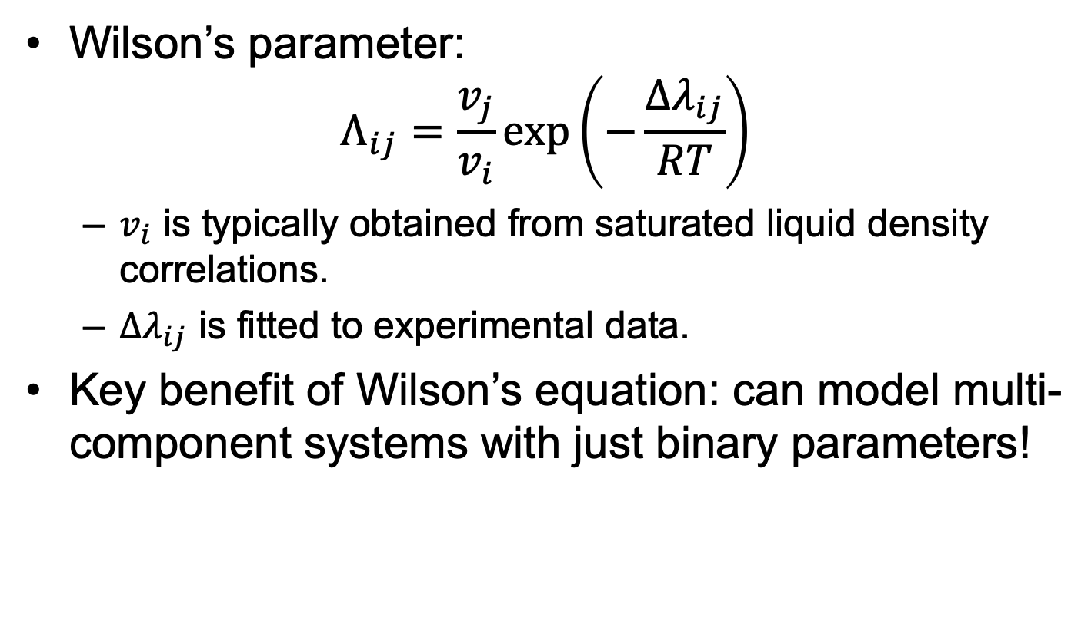
Wilson Equation
Wilson’s parameter: $Λ_{ij}=\frac{v_{j}}{v_{i}}\exp\left(−\frac{Δλ_{ij}}{RT}\right)$
$v_{i}$ is typically obtained from saturated liquid density correlations.
$Δλ_{ij}$ is fitted to experimental data.
Key benefit of Wilson’s equation: can model multi-component systems with just binary parameters!

Slide 16
Wilson Equation
Is typically used for hydrogen-bonding systems:

Slide 17
Wilson Equation
N.B.: One of the key disadvantages of the Wilson equation is that is can’t predict liquid-liquid equilibrium / immiscibility.
Limited number of systems it can model.

Slide 18
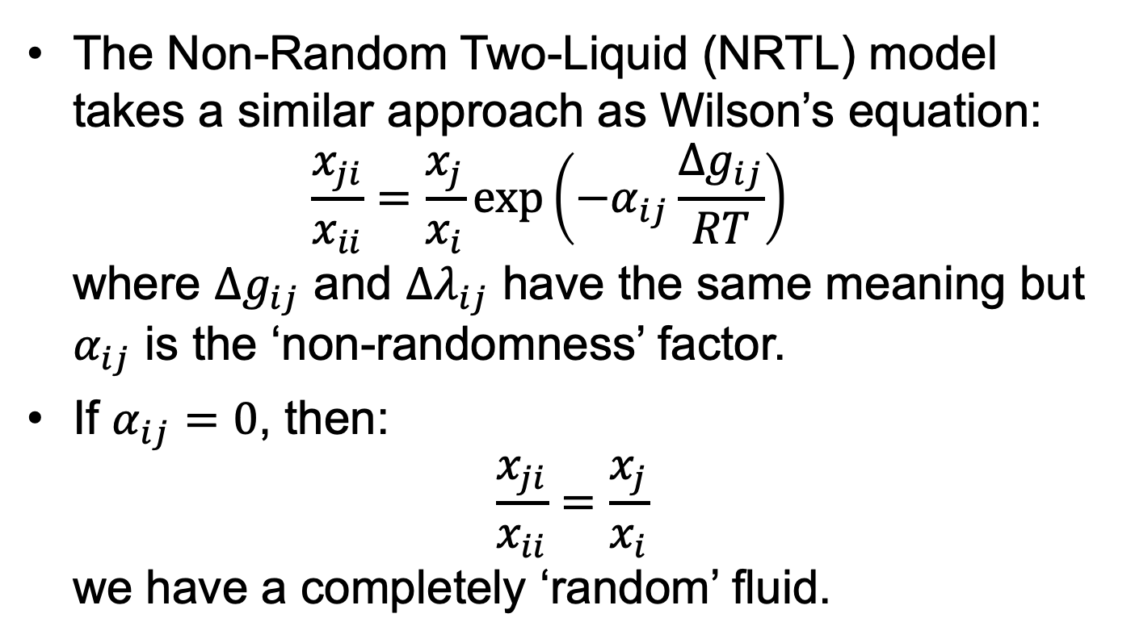
NRTL Model
The Non-Random Two-Liquid (NRTL) model takes a similar approach as Wilson’s equation: $\frac{x_{ji}}{x_{ii}}=\frac{x_{j}}{x_{i}}\exp\left(−α_{ij}\frac{Δg_{ij}}{RT}\right)$ where $Δg_{ij}$ and $Δλ_{ij}$ have the same meaning but $α_{ij}$ is the ‘non-randomness’ factor.
If $α_{ij}=0$, then: $\frac{x_{ji}}{x_{ii}}=\frac{x_{j}}{x_{i}}$ we have a completely ‘random’ fluid.

Slide 19
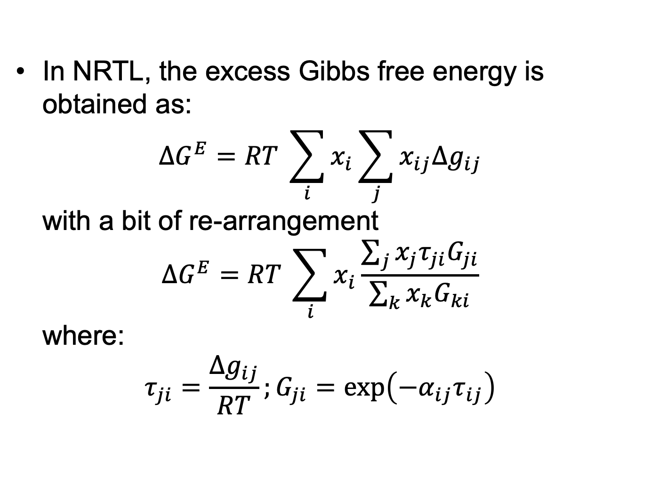
NRTL Model
In NRTL, the excess Gibbs free energy is obtained as: $ΔG^{E}=RT \sum_{i}{x_{i}\sum_{j}{x_{ij}Δg_{ij}}}$ with a bit of re-arrangement $ΔG^{E}=RT \sum_{i}{x_{i}\frac{\sum_{j}{x_{j}τ_{ji}G_{ji}}}{\sum_{k}{x_{k}G_{ki}}}}$ where: $τ_{ji}=\frac{Δg_{ij}}{RT};G_{ji}=\exp\left(−α_{ij}τ_{ij}\right)$

Slide 20
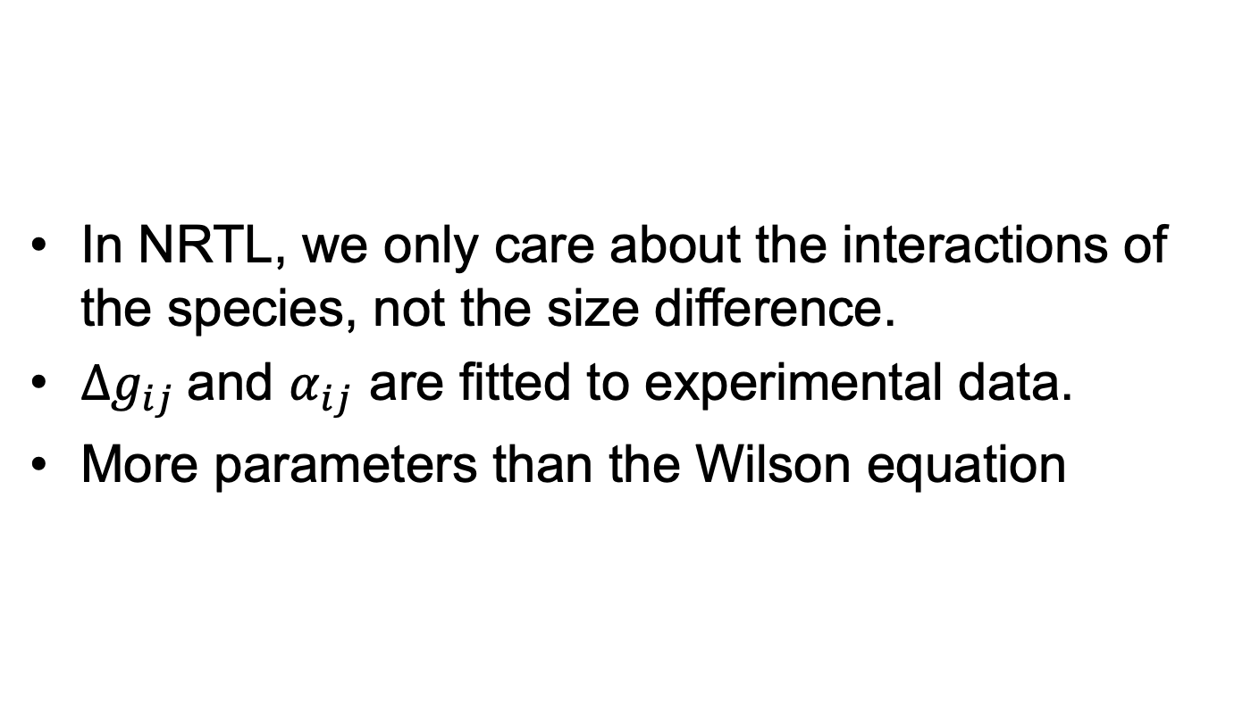
NRTL Model
In NRTL, we only care about the interactions of the species, not the size difference.
$Δg_{ij}$and $α_{ij}$ are fitted to experimental data.
More parameters than the Wilson equation

Slide 21
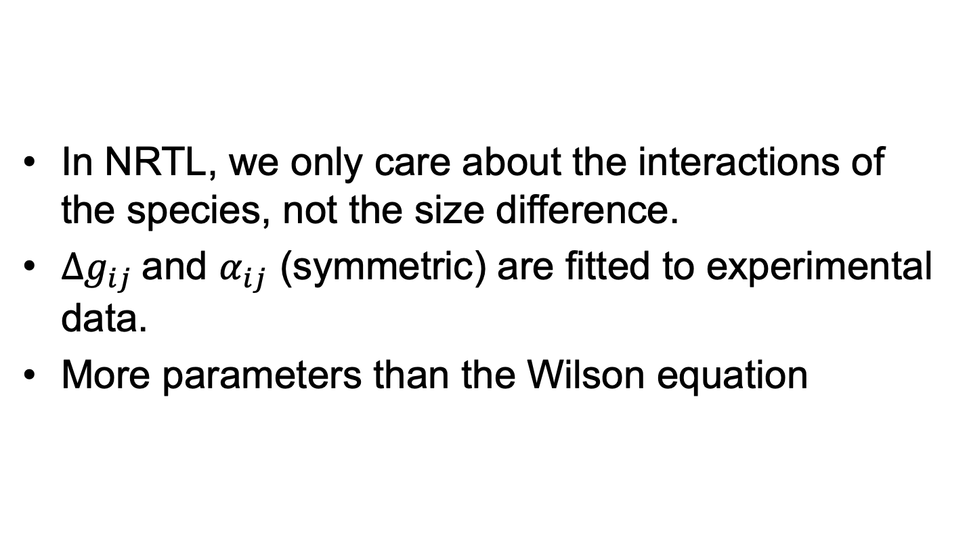
NRTL Model
In NRTL, we only care about the interactions of the species, not the size difference.
$Δg_{ij}$and $α_{ij}$ (symmetric) are fitted to experimental data.
More parameters than the Wilson equation

Slide 22
NRTL Model
The big innovation of NRTL is that it could predict liquid-liquid equilibria:

Slide 23
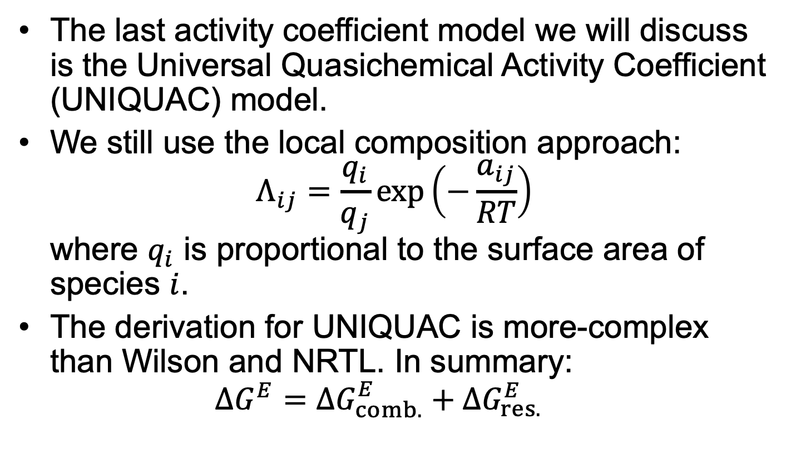
UNIQUAC Model
The last activity coefficient model we will discuss is the Universal Quasichemical Activity Coefficient (UNIQUAC) model.
We still use the local composition approach: $Λ_{ij}=\frac{q_{i}}{q_{j}}\exp\left(−\frac{a_{ij}}{RT}\right)$ where $q_{i}$ is proportional to the surface area of species $i$.
The derivation for UNIQUAC is more-complex than Wilson and NRTL. In summary: $ΔG^{E}=ΔG_{comb.}^{E}+ΔG_{res.}^{E}$

Slide 24
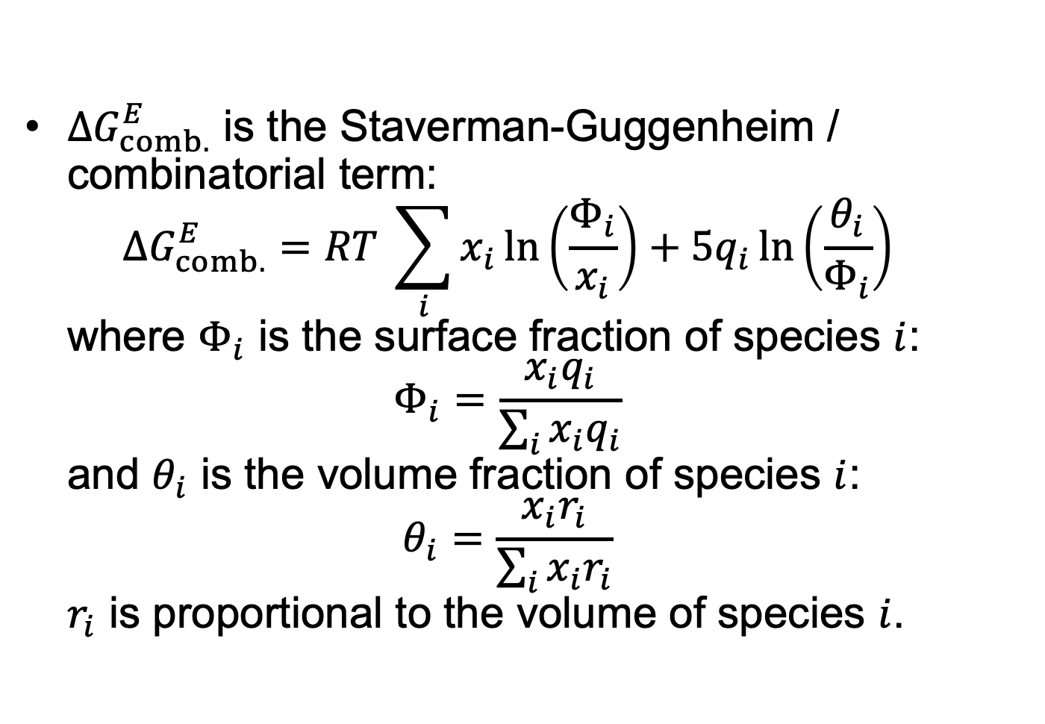
UNIQUAC Model
$ΔG_{comb.}^{E}$ is the Staverman-Guggenheim / combinatorial term: $ΔG_{comb.}^{E}=RT \sum_{i}{x_{i}\ln\left(\frac{Φ_{i}}{x_{i}}\right)+5q_{i}\ln\left(\frac{θ_{i}}{Φ_{i}}\right)}$ where $Φ_{i}$ is the surface fraction of species $i$: $Φ_{i}=\frac{x_{i}q_{i}}{\sum_{i}{x_{i}q_{i}}}$ and $θ_{i}$ is the volume fraction of species $i$: $θ_{i}=\frac{x_{i}r_{i}}{\sum_{i}{x_{i}r_{i}}}$ $r_{i}$ is proportional to the volume of species $i$.

Slide 25

UNIQUAC Model
$ΔG_{comb.}^{E}$ can be thought of as the entropic term.
We account for the change in disorder when mixing species of different size in the same system.
$q_{i}$ and $r_{i}$ are both fitted to experimental data.

Slide 26
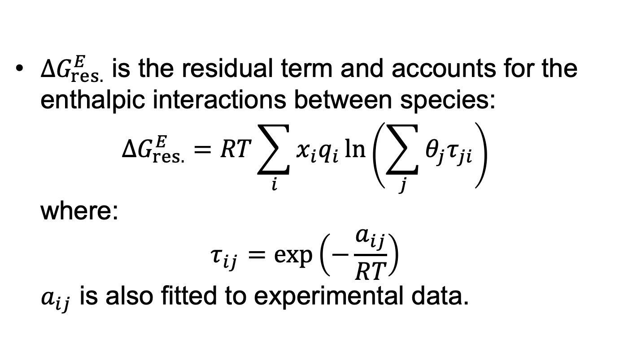
UNIQUAC Model
$ΔG_{res.}^{E}$ is the residual term and accounts for the enthalpic interactions between species: $ΔG_{res.}^{E}=RT\sum_{i}{x_{i}q_{i}\ln\left(\sum_{j}{θ_{j}τ_{ji}}\right)}$ where: $τ_{ij}=\exp\left(−\frac{a_{ij}}{RT}\right)$ $a_{ij}$ is also fitted to experimental data.

Slide 27
UNIQUAC Model
Comparing Wilson, NRTL and UNIQUAC, the performance is entirely dependent on how well the parameters are fitted:
N.B.: UNIQUAC can predict LLE!

Slide 28
UNIFAC Model
The last approach discussed is an extension of UNIQUAC: UNQUAC Functional-group Activity Coefficient (UNIFAC) model.
It is a group-contribution based approach (i.e. more extensible than UNIQUAC)
The formalism is the same as UNIQUAC. We are now concerned about the local composition around groups instead of species.

Slide 29
UNIFAC Model
Interestingly, despite being a group-contribution based method, it can be more-accurate than UNIQUAC:

Slide 30
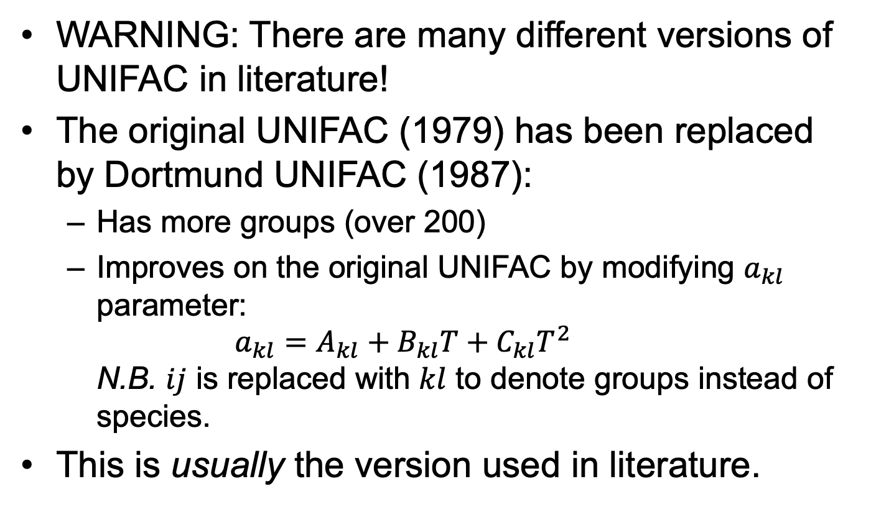
UNIFAC Model
WARNING: There are many different versions of UNIFAC in literature!
The original UNIFAC (1979) has been replaced by Dortmund UNIFAC (1987):
Has more groups (over 200)
Improves on the original UNIFAC by modifying $a_{kl}$ parameter: $a_{kl}=A_{kl}+B_{kl}T+C_{kl}T^{2}$ N.B. $ij$ is replaced with $kl$ to denote groups instead of species.
This is usually the version used in literature.

Slide 31
Key Points
Activity coefficient models provide easy ways to obtain complex equilibrium problems, with some limitations:
Subcritical region only
Needs an ancillary model to be useful and obtain bulk properties.
Wilson is limited to just vapour-liquid equilibrium
Most activity coefficient models account for size and energetic interactions.

Slide 32
Key Points
Up to the parameterization, the various activity coefficient models perform similarly.
UNIFAC provides a method to predict vapour-liquid equilibrium using a GC approach.
Many version of UNIFAC exist in literature and need to be used carefully.

